Slide 1
Judah Alone
Lesson 21
Jehoiakim’s Last Days
2 Kings 24, 25:27-30
2 Chron 36:9-10
Jeremiah 22, 23, 24, 27, 28, 29, 30, 31

Slide 2
This Day In History 2600 Years Ago
Nineveh has been destroyed by the Medes and Babylonians
Josiah is dead
Jehoahaz (Josiah’s son) has been taken captive to Egypt by Pharaoh Necho
Eliakim/Jehoiakim (Josiah’s son) has paid a massive tax (100 talents of silver a 1 talent of gold) to Egypt by taxing the people
The first wave of captives has been take to Babylon

Slide 4
Today’s Lesson
Jehoiakim’s Last Days
Jehoiachin (Coniah, Jeconiah)
Zedekiah (Mattaniah)
Jeremiah and Hananiah

Slide 5
Jehoiakim’s Last Days

Slide 6
Jehoiakim’s Last Days
Jehoiakim reigned from 609BC to 598BC
In 605BC - About 3 to 4 years into his reign - the first captives were taken to Babylon (Daniel, etc)
Jehoiakim served Babylon for 3 years – then rebelled!
God sent raiders from the Chaldeans, Syrians, Moabites, and Ammonites against Judah
This was because of all the innocent blood Manasseh had shed “which the Lord would not pardon”

Slide 7
Jehoiakim’s Last Days
No mention is given to how Jehoiakim died BUT… (Jer 22:18-19)
Therefore thus says the Lord concerning Jehoiakim the son of Josiah, king of Judah: “They shall not lament for him, Saying, ‘Alas, my brother!’ or ‘Alas, my sister!’
They shall not lament for him, Saying, ‘Alas, master!’ or ‘Alas, his glory!’
He shall be buried with the burial of a donkey,
Dragged and cast out beyond the gates of Jerusalem.

Slide 8
Jehoiakim’s Last Days
Jeremiah 36:30
Therefore thus says the Lord concerning Jehoiakim king of Judah: “He shall have no one to sit on the throne of David, and his dead body shall be cast out to the heat of the day and the frost of the night.

Slide 9
Jehoiachin (Coniah, Jeconiah)

Slide 10
Jehoiachin (Coniah, Jeconiah)
Was only 18 when he became king
He reigned for 3 months
He did evil in the sight of the Lord
Nebuchadnezzar besieged Jerusalem in the 8th year of his reign of Babylon
Jehoiachin, his mother, his servants, his princes, and his officers surrendered to Nebuchadnezzar

Slide 11
Jehoiachin (Coniah, Jeconiah)
Nebuchadnezzar also took:
The king’s wives
All the treasures of the Lord’s house
All the treasures of the king’s house

Slide 12
Jehoiachin (Coniah, Jeconiah)
Nebuchadnezzar also took:
All the captains and mighty men of valor
All the craftsmen and smiths
All the articles of gold Solomon had made in the temple
“None remained except the poorest people of the land”
It was 597BC

Slide 13
Jehoiachin (Coniah, Jeconiah)
What did God think of Coniah?
Read Jer 22:24-30
God said that none of Coniah’s (Jehoiachin’s) descendants shall prosper “sitting on the throne of David, and ruling anymore in Judah”
Coniah is in the lineage of Jesus – Matt 1:12-16

Slide 14
Jehoiachin (Coniah, Jeconiah)
Mary was told by the angel (Luke 1:31-33)
“And behold, you will conceive in your womb and bring forth a Son, and shall call His name Jesus. He will be great, and will be called the Son of the Highest; and the Lord God will give Him the throne of His father David. And He will reign over the house of Jacob forever, and of His kingdom there will be no end.”

Slide 15
Jehoiachin (Coniah, Jeconiah)
Peter said on Pentecost (Acts 2:30)
“Therefore, (David) being a prophet, and knowing that God had sworn with an oath to him that of the fruit of his body, according to the flesh, He would raise up the Christ to sit on his throne”

Slide 16
Jehoiachin (Coniah, Jeconiah)
So if Jesus is the Christ who is sitting on David’s throne
And Jesus is descended from Jeconiah
How does this fit with none of Jeconiah’s descendants prospering on the throne?

Slide 17
Jehoiachin (Coniah, Jeconiah)
God said that none of Coniah’s (Jehoiachin’s) descendants shall prosper “sitting on the throne of David, and ruling anymore in Judah”
This rules out what some people believe about Jesus coming back to earth to rule in Jerusalem

Slide 18
Zedekiah (Mattaniah)

Slide 19
Zedekiah (Mattaniah)
Nebuchadnezzar made Mattaniah king
He was Jehoiakim’s brother and another of Josiah’s sons
Nebuchadnezzar changed his name to Zedekiah
Zedekiah was 21 when he became king
He reigned for 11 years
He did evil in the sight of the Lord
He rebelled against the king of Babylon

Slide 20
Zedekiah (Mattaniah)
What did God think of Zedekiah?
Read Jeremiah 24:1-10

Slide 21
Zedekiah (Mattaniah)
During Zedekiah’s reign, Jeremiah sent a letter to the captives in Babylon (Jer 29:1-32)
It said: (basically, make the best of the situation)
Build houses and dwell in them
Plant gardens and eat their fruit

Slide 22
Zedekiah (Mattaniah)
Jeremiah’s letter (cont.)
Take wives, have children
“that you may be increased there, and not diminished”
Pray for the peace of the city where you are captive
Don’t listen to prophets who tell you otherwise

Slide 23
Zedekiah (Mattaniah)
Jeremiah’s letter (cont.)
After 70 years, God would return them to Jerusalem
For I know the thoughts that I think toward you, says the Lord, thoughts of peace and not of evil, to give you a future and a hope." (Jer 29:11)

Slide 24
Zedekiah (Mattaniah)
Jeremiah’s letter (cont.)
"You will seek Me and find Me, when you search for Me with all your heart“ (Jer 29:13)
God would bring them back from all the nations where you have been taken

Slide 25
Jeremiah and Hananiah

Slide 26
Jeremiah and Hananiah
Jer 27:1-28:17
God told Jeremiah to make bonds and yokes and send them to the kings of:
Edom
Moab
Ammon
Tyre
Sidon

Slide 27
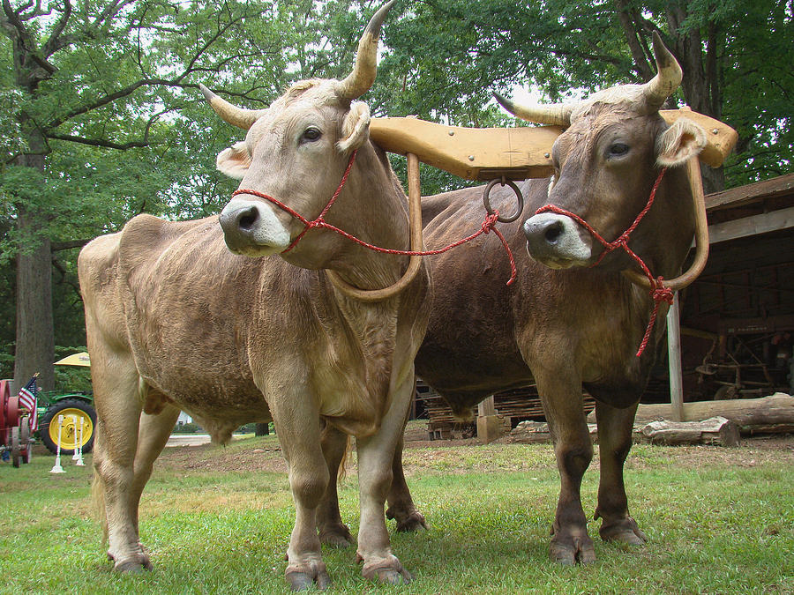

Slide 28
Jeremiah and Hananiah
Jer 27:1-28:17
Jeremiah sent the yokes with a message to the kings:
God has given the land (and the animals) to the Babylonians
If you don’t put on the yoke (serve) of the Babylonians, God would punish them with Sword, Famine, and Pestilence!
Don’t listen to prophets who tell you otherwise
If you serve Babylon, God would let them remain in their own land, till it, and dwell in it

Slide 29
Jeremiah and Hananiah
Jeremiah sent the same message to Zedekiah
Jeremiah also told the priests and all the people the same message:
Don’t believe prophets who say the vessels of the Lord’s house will shortly come back
Nebuchadnezzar was going to take the rest of the vessels of the Lord’s house to Babylon

Slide 30
Jeremiah and Hananiah
Hananiah was prophesying just the opposite. He said in 2 years:
God would bring back all the vessels of the Lord’s house
God would bring back Jeconiah the son of Jehoiakim
God would bring back all the captives of Judah

Slide 31
Jeremiah and Hananiah
Jeremiah told Hananiah Amen! Let what you said happen
BUT the real proof of a prophet of the Lord is if what they say comes to pass
Hananiah took Jeremiah’s yoke and broke it and said that God said:
“Even so I will break the yoke of Nebuchadnezzar….within the space of 2 full years”

Slide 32
Jeremiah and Hananiah
Jeremiah left
God sent Jeremiah back to say that an iron yoke would replace the wooden one. The people would serve Babylon!
God, through Jeremiah, told Hananiah:
“Behold, I will cast you from the face of the earth. This year you shall die, because you have taught rebellion against the Lord”

Slide 33
Jeremiah and Hananiah
Hananiah died the same year in the 7th month

Slide 34
Jehoiachin (Coniah, Jeconiah)
2 Kings 25-30
Jehoiachin was released from prison in Babylon in the 37th year of his captivity by Evil-Merodach, king of Babylon
He gave him a more prominent seat than those of the kings who were with him in Babylon
He gave him a regular portion of food for each day for the rest of his life

Slide 35
Jehoiachin (Coniah, Jeconiah)
Jehoiachin regularly “ate bread” before the Babylonian king

Slide 37
Summary

Slide 38
Next Class
The Fall of Jerusalem

Slide 39
For Extra Credit…

